Slide 1

121 CLAY BIRD LANE • BRIARCLIFF MANOR / MOUNT PLEASANT, NY
A Documented Pattern of Fire
& Emergency Response Failures
Fire & Emergency Response History — 2014 – 2026
Compiled from NFIRS FOIL records, Westchester County dispatch audio and fire reports, individual department records, and independent news coverage.
Prepared August 2026

Slide 2
BY THE NUMBERS
Twelve years. One address. A documented pattern.
32
24
9 of 12
Emergency responses documented
(2014–2026)
Confirmed or dispatch-coded
fire events
Years with at least one
fire-related emergency call
The single largest event: December 8, 2024
~17 fire departments • 11+ water tankers (no hydrants at the site; total gallons not confirmed in public source) Estimated water usage close to 1 Million gallons • Burned 7+ hours, dispatched ~12:45 AM • Official cause: UNDETERMINED — smoke was visible over neighboring homes and properties for days afterward. Smoke could be smelled inside homes. Whatever the cause, burning mulch this close to residences is an air-quality and health & safety risk in its own right — and the same runoff feeds the wetlands and streams that lead to residents' private drinking-water wells.
121 Clay Bird Lane — Fire & Emergency Response History
2

Slide 3
THE PATTERN OVER TIME
Emergency responses to this address, by year
2017, 2020, 2023, and 2025 show no emergency records for this address in the material reviewed.
121 Clay Bird Lane — Fire & Emergency Response History
3

Slide 4





THE CASE FOR CONCERN
Why this site appears unsafe
Extremely high call frequency for one address
Fire or fire-adjacent emergency calls in at least 9 of the last 12 years — an unusual concentration for a single site.
No fire hydrants at the site
Every major fire (2015, 2016, 2024, 2026) required mutual-aid tanker shuttles; the largest event trucked water in from Putnam and Orange counties.
Cause repeatedly undetermined or unresolved
The site's own equipment has independently caught fire multiple times, yet the largest fire on record (12/8/2024) was never given a determined cause, but another brush fire was reported 3 weeks prior (11/15/24).
The Town owns this land — and was cited too
Mount Pleasant filed an open, pending lawsuit against Amodio's Garden Center on 6/12/2026 — but the Town itself has also received two DEC violation notices for this Town-owned site, most recently July 21, 2026.
Incomplete official recordkeeping
The county FOIL production did not include completed NFIRS reports for the 2026 fire dispatches; local FD/NERIS records should be used as backup where available.
121 Clay Bird Lane — Fire & Emergency Response History
4

Slide 5
EARLY WARNING SIGNS
2014 – 2016: nine incidents in three years
Sept. 30 –
Oct. 1, 2014
Two-day mulch fire — predates the fire department's own FOIL production
11 mutual-aid departments plus Westchester County DES responded; over 120,000 gallons shuttled by tanker. This fire is not in the county's official record set at all — found only through independent fire-department news archives.
Feb. –
Oct. 2015
Seven fire responses in eight months
Includes two records where fire crews explicitly left a pile to smolder/burn under monitoring rather than fully extinguishing it (7/30 and 7/31/2015).
Sept. 25–28,
2016
Likely under-reported fire duration
A 9:10 PM fire call on 9/25/2016 was never completed as an official record. Strong evidence (matching time/location in a Millwood FD news report) suggests it was the true start of the fire "officially" logged the next afternoon.
121 Clay Bird Lane — Fire & Emergency Response History
5

Slide 6
THE GAP YEARS, FILLED IN
2018 – 2022: records this workbook restored
2018 –
2019
Two smoke investigations previously missing from the record
7/26/2018 and 11/26/2019 — both absent from prior summaries; closes what looked like a multi-year gap in site activity.
Dec. 30–31,
2021
Equipment fire two days in a row
Site operator's own grinding equipment caught fire on consecutive days; second incident's cause was still listed as "under investigation."
Oct. 2022 &
Nov. 2024
A medical emergency, then an unreported brush fire
10/12/2022: EMS call at the site. 11/15/2024: a BRUSH-coded fire dispatch just 3.5 weeks before the massive 12/8/2024 fire — with no NFIRS report ever filed.
121 Clay Bird Lane — Fire & Emergency Response History
6

Slide 7
SPOTLIGHT
December 8, 2024 — The Largest Fire on Record
17
11+
7+
UNDET.
fire departments
responded
water tankers
reported
hours to bring
under control
official cause
determination
Dispatched ~12:45 AM as a reported brush fire on the Taconic State Parkway — no fire was found there.
A large smoke plume led crews to a fully involved mulch pile fire on Clay Bird Lane instead. With no hydrants nearby, tankers were called from as far as Putnam and Orange counties. Westchester County DES supplied radios and batteries through the overnight cold. Despite the scale of the response, the fire department's own investigation never determined a cause.
Fire event independently confirmed by Daily Voice, Hudson Valley Country/97.7 The Wolf, News 12 Westchester, and fire-service posts. Water quantity removed pending source confirmation.
121 Clay Bird Lane — Fire & Emergency Response History
7

Slide 8

THE MOST RECENT YEAR
2026: six fire/related dispatches; NFIRS gaps now backed up with local/NERIS records
4/8
4/8
4/14
10:28 AM — Brush fire dispatch; declared "contained"
10:30 PM — Same address, second same-day dispatch; escalated overnight
7:41 AM — Only 2026 incident with full unit detail (via separate dept. report): Engine 92, Engine 93, Car 2052 + mutual aid
5/15
5/16
6/27
10:18 AM — Dispatch location explicitly logged as "mulch pile"
4:53 AM — Medical/EMS follow-up call, same site, next morning
10:55 AM — Outside investigation, most recent record in the file
County FOIL fields remain incomplete, but the backup should be updated with local FD/NERIS records where available. Do not treat missing NFIRS fields as proof no detailed report exists.
121 Clay Bird Lane — Fire & Emergency Response History
8

Slide 9
A RECURRING STRUCTURAL PROBLEM
No fire hydrants serve this site
Neighboring properties rely on private wells fed by the same wetlands and streams that run through this site. Every significant fire here has required an emergency mutual-aid tanker relay because there are no hydrants — which also means longer burns, and longer smoke exposure for residents. Whatever caused each fire, that is an air-quality and health & safety issue on its own.
7/30/2015
"Multiple tankers called in mutual aid due to no hydrants in area." (NFIRS remarks, verbatim)
9/2016
Tankers requested from Pleasantville, Croton-on-Hudson, and Pocantico Hills for a large brush fire at the same site.
11/15/2024
Dispatched as a brush fire — just 3.5 weeks before the major 12/8/2024 blaze — but the department never completed an NFIRS report for it. No cause, no narrative on file.
12/8/2024
11+ tankers reported; water shuttled from as far as Putnam and Orange counties. Total gallons not confirmed in cited public source.
4/14/2026
Department report: "FD requested tankers from neighboring departments" — same pattern, most recent confirmed fire.
121 Clay Bird Lane — Fire & Emergency Response History
9

Slide 10
DOCUMENTED IN THE FIRE DEPARTMENT'S OWN WORDS
A pattern of incomplete extinguishment
7/31/2015
"Contained organic waste on fire, contractor cut fire line around affected area and left to burn, town will monitor the area."
7/11/2021
"FD arrived to find the mulch pile that was supposed to be dismantled the prior day smoldering. Required an additional 30,000 gallons to extinguish."
Both quotes are verbatim from official NFIRS incident remarks fields.
121 Clay Bird Lane — Fire & Emergency Response History
10

Slide 11
THE TOWN'S OWN POSITION
Mount Pleasant has an open, pending lawsuit against the site operator
Trespass & Public Nuisance — filed June 12, 2026, Westchester Supreme Court
Amodio's Garden Center allegedly trucked in ~10,000 cubic yards of outside material since August 2025 — including soil from Metropolis Golf Course in Greenburgh — far beyond its historical arrangement to mulch only Town-supplied branches.
The Town alleges the resulting piles "smolder and could catch fire" and exceed the state's 25-ft-high / 30-ft-wide stockpile limit.
NYSDEC separately charged the operator with running the facility without authorization and accepting construction/demolition debris without authorization.
Independent testing (Laurel Environmental Geosciences) reportedly found volatile organic compounds, metals, and pesticides in site materials.
The Town is demanding the material be removed and the site restored "to a safe and lawful condition"; the operator has reportedly demanded $3 million to do so.
Source: Westfair Communications, "Amodio's Garden Center accused of creating nuisance," 6/24/2026 (Bill Heltzel)
121 Clay Bird Lane — Fire & Emergency Response History
11

Slide 12
THE TOWN WAS CITED TOO
Four DEC violation notices since Feb. 2025 — two issued directly to the Town
The site is Town-owned property
121 Clay Bird Lane operates on land under the ownership, custody, or control of the Town of Mount Pleasant. DEC violations attach to whoever holds that responsibility — not only the operator leasing it.
Feb. 18, 2025 — NOV to the Town itself
NYSDEC cited Town Highway Superintendent Richard Benkwitt directly for operating an unauthorized yard-trimmings compost facility on Town of Mount Pleasant property. A separate, same-day notice cited operator Nicholas Amodio for operating without any registration or permit.
May 12, 2026 — Second NOV to the operator
Following inspections on 1/9, 4/9, and 4/17/2026, DEC cited Amodio for running an unauthorized construction-and-demolition debris handling and recovery facility, and for accepting C&D waste without authorization.
July 21, 2026 — NOV directly to Supervisor Fulgenzi
Following a 7/16/2026 inspection, DEC cited the Town of Mount Pleasant itself — not just the operator — for continued unauthorized operation and illegal landfilling of mixed C&D debris on a slope facing the Taconic State Parkway.
DEC's own photos confirm elevated lead
The July 2026 inspection report includes a photo captioned “Pile sampled to have elevated lead levels — tarped off,” independently corroborating what residents have raised since May 2026.
121 Clay Bird Lane — Fire & Emergency Response History
12

Slide 13
WHERE THE MATERIAL CAME FROM
Three distinct sources feeding one contaminated site
Golf-course-origin fill
Per the Town's own June 2026 lawsuit, soil was trucked in from Metropolis Golf Course in Greenburgh. Alpha-chlordane — a legacy turf pesticide — found in site testing is typically consistent with this origin.
Town-sourced pond-dredging material
The Town itself brought in dredging spoils from a local pond — Carroll Park / Leith Pond. This was a DEC-approved project, but certain soil elements reportedly had elevated chromium and other contaminants, which the Town claims to have sorted out. Residents have not yet been provided proof and remain waiting on their pending FOIL request.
Mixed construction & demolition debris
DEC's July 2026 inspection photographed wood chips, rock, and soil mixed with brick, slag, and concrete — plus mulch migrating over the bank toward the Taconic State Parkway slope.
Lead result: 854 — about 13x the residential limit
854 is roughly 13.5 times New York State's residential (unrestricted use) soil cleanup objective for lead of 63 mg/kg (6 NYCRR Part 375). Mercury and alpha-chlordane were also identified.
Two independent lead sources on one parcel
The site also hosts the Mount Pleasant Sportsmen's Club shooting range, with a police shooting-practice range in the same vicinity — both well-documented sources of soil lead, separate from the fill described above.
121 Clay Bird Lane — Fire & Emergency Response History
13

Slide 14
THE FULL RECORD
All 32 documented incidents, 2014–2026 (1 of 11)
# | Date | Alarm / Start Time | Controlled / Last Unit Clear | Dur. (hrs) | Category | Incident Number(s) | Mutual Aid? | Departments / Units Identified | Apparatus (counts) | Personnel (counts) | Ignition Area / Heat Source / Material | Remarks / Key Facts (often verbatim from record)
1 | 9/30/2014 (approx.) - 10/1/2014 | ~9:15 PM 9/30/2014 (per news) | ~2:30 PM 10/1/2014 (per news) | ~29 (2-day operation, news-reported) | FIRE — Confirmed (news source; NOT in official FOIL production) | Not in FOIL record set (predates 11/20/2014 start of file) | Yes — 11 departments + County DES | Croton-on-Hudson FD (2089, Tanker 10); Briarcliff Manor FD (2051, 2052, 2053, Engine 92, Engine 93, TL40, R37, U62); Ossining FD (2332, 2334, Engine 97, Engine 99, L41); Chappaqua FD (2062, Engine 146, TL27 — substituted for BMFD TL40 on day 2 due to mechanical issue); Bedford Hills FD (2033, Tanker 5); Continental Village FD (2131, Tanker 11); Pocantico Hills FD (2381, 2382, Tanker 12); Yorktown Heights FD (2531, Tanker 14); Millwood FD (2252, Tanker 15); Pleasantville FD (2373, Tanker 57); White Plains FD (Engine 66); Westchester County DES (B11, CC4, U70); OVAC (ambulance corps) | — | — | Mulch/yard waste pile with large logs, 50-60 ft high | Two-day operation: BMFD dispatched Tuesday AM for outside odor of smoke; found significant fire in 50-60 ft pile. Units recalled to same scene Wednesday, nearly same time, for second day of tanker operations. Briarcliff's ladder tanker (TL40) had a mechanical issue on day 2 and had to be replaced by Chappaqua's TL27.
2 | 11/20/2014 | 11/20/2014 14:08:44 | 11/20/2014 14:59:04 | 0.8h | FIRE — Confirmed (official NFIRS record) | 2014-000677 + 2014-000678 | None | Not specified by call sign in NFIRS summary (Briarcliff Manor FD primary; see aggregate counts) | Fire: 3 | EMS: 0 | Other: 3 | Fire: 7 | EMS: 1 | Other: 0 | Engine area, running gear, wheel area; heat source: heat from powered equipment, other; material: flammable liquid/gas in/from engine or burner | 2008 Komptech Crambo 6000 grinder involved (S/N WJH 02632 or 109044). Owner: Ray Colasacco. Business: Evergreen Organic Recycling. Property use: "Dump, sanitary landfill."
121 Clay Bird Lane — Fire & Emergency Response History
14

Slide 15
THE FULL RECORD
All 32 documented incidents, 2014–2026 (2 of 11)
# | Date | Alarm / Start Time | Controlled / Last Unit Clear | Dur. (hrs) | Category | Incident Number(s) | Mutual Aid? | Departments / Units Identified | Apparatus (counts) | Personnel (counts) | Ignition Area / Heat Source / Material | Remarks / Key Facts (often verbatim from record)
3 | 2/3/2015 | 2/3/2015 14:49:45 | 2015-02-03 17:50:46 | 3.0h | FIRE — Confirmed (official NFIRS record) | 2015-000083 | None | Not specified by call sign in NFIRS summary (Briarcliff Manor FD primary; see aggregate counts) | Fire: 2 | EMS: 0 | Other: 1 | Fire: 7 | EMS: 0 | Other: 5 | Open area, outside; included are farmland, field; heat source: Spontaneous combustion, chemical reaction; material: Heavy vegetation - not crop, including trees | "Controlled" date/time is recorded as 3/2/2015 17:45 — nearly a month after the 2/3/2015 alarm — an anomaly preserved from the source record; may reflect a data-entry/paperwork issue or an unusually long smolder that was never flagged for follow-up.
4 | 2/7/2015 | 2/7/2015 11:43:03 | 2/7/2015 14:13:02 | 2.5h | FIRE — Confirmed (official NFIRS record) | 2015-000091 | None | Not specified by call sign in NFIRS summary (Briarcliff Manor FD primary; see aggregate counts) | Fire: 2 | EMS: 0 | Other: 2 | Fire: 7 | EMS: 0 | Other: 6 | Open area, outside; included are farmland, field; heat source: Spontaneous combustion, chemical reaction; material: Heavy vegetation - not crop, including trees | —
5 | 7/30/2015 | 7/30/2015 8:07:32 | 7/30/2015 12:36:53 | 4.5h | FIRE — Confirmed (official NFIRS record) | 2015-000530 + 2015-000487-A | Mutual aid received | Not specified by call sign in NFIRS summary (Briarcliff Manor FD primary; see aggregate counts) | Fire: 4 | EMS: 0 | Other: 2 | Fire: 7 | EMS: 0 | Other: 4 | "ORGANIC WASTE DUMP, FIRE CAUSED BY HEAT FROM DECOMPOSITION. | "ORGANIC WASTE DUMP, FIRE CAUSED BY HEAT FROM DECOMPOSITION. MULTIPLE TANKERS CALLED IN MUTUAL AID DUE TO NO HYDRANTS IN AREA." (verbatim from NFIRS remarks)
121 Clay Bird Lane — Fire & Emergency Response History
15

Slide 16
THE FULL RECORD
All 32 documented incidents, 2014–2026 (3 of 11)
# | Date | Alarm / Start Time | Controlled / Last Unit Clear | Dur. (hrs) | Category | Incident Number(s) | Mutual Aid? | Departments / Units Identified | Apparatus (counts) | Personnel (counts) | Ignition Area / Heat Source / Material | Remarks / Key Facts (often verbatim from record)
6 | 7/31/2015 | 7/31/2015 4:51:56 | 7/31/2015 5:58:09 | 1.1h | FIRE — Confirmed (official NFIRS record) | 2015-000534 | None | Not specified by call sign in NFIRS summary (Briarcliff Manor FD primary; see aggregate counts) | Fire: 2 | EMS: 0 | Other: 3 | Fire: 2 | EMS: 0 | Other: 6 | "CONTAINED ORGANIC WASTE ON FIRE, CONTRACTOR CUT FIRE LINE AROUND AFFECTED AREA AND LEFT TO BURN, TOWN WILL MONITOR THE AREA. | "CONTAINED ORGANIC WASTE ON FIRE, CONTRACTOR CUT FIRE LINE AROUND AFFECTED AREA AND LEFT TO BURN, TOWN WILL MONITOR THE AREA." (verbatim) — the fire was deliberately left to burn rather than fully extinguished.
7 | 8/1/2015 | 8/1/2015 10:23:29 | 8/1/2015 14:35:48 | 4.2h | FIRE — Confirmed (official NFIRS record) | 2015-000537 | Mutual aid received | Not specified by call sign in NFIRS summary (Briarcliff Manor FD primary; see aggregate counts) | Fire: 1 | EMS: 0 | Other: 2 | Fire: 5 | EMS: 0 | Other: 5 | Open area, outside; included are farmland, field; heat source: Spontaneous combustion, chemical reaction; material: Heavy vegetation - not crop, including trees | —
8 | 8/17/2015 | 8/17/2015 8:50:50 | 8/17/2015 8:57:25 | 0.1h | FIRE — Confirmed (official NFIRS record) | 2015-000566 | None | Not specified by call sign in NFIRS summary (Briarcliff Manor FD primary; see aggregate counts) | Fire: 2 | EMS: 0 | Other: 1 | Fire: 2 | EMS: 0 | Other: 6 | Open area, outside; included are farmland, field; heat source: Spontaneous combustion, chemical reaction; material: Heavy vegetation - not crop, including trees | —
121 Clay Bird Lane — Fire & Emergency Response History
16

Slide 17
THE FULL RECORD
All 32 documented incidents, 2014–2026 (4 of 11)
# | Date | Alarm / Start Time | Controlled / Last Unit Clear | Dur. (hrs) | Category | Incident Number(s) | Mutual Aid? | Departments / Units Identified | Apparatus (counts) | Personnel (counts) | Ignition Area / Heat Source / Material | Remarks / Key Facts (often verbatim from record)
9 | 8/21/2015 | 8/21/2015 22:52:15 | 8/21/2015 23:13:29 | 0.3h | Smoke/Odor Investigation (NFIRS 651 — not coded as a confirmed fire) | 2015-000575 | None | Not specified by call sign in NFIRS summary (Briarcliff Manor FD primary; see aggregate counts) | Fire: 2 | EMS: 0 | Other: 1 | Fire: 10 | EMS: 0 | Other: 5 | N/A — investigation call | —
10 | 10/1/2015 | 10/1/2015 4:35:12 | 10/1/2015 5:00:07 | 0.4h | FIRE — Confirmed (official NFIRS record) | 2015-000673 | None | Not specified by call sign in NFIRS summary (Briarcliff Manor FD primary; see aggregate counts) | Fire: 2 | EMS: 0 | Other: 3 | Fire: 1 | EMS: 0 | Other: 5 | Open area, outside; included are farmland, field; heat source: Spontaneous combustion, chemical reaction; material: Heavy vegetation - not crop, including trees | —
11 | 10/1/2015 | 10/1/2015 8:19:51 | 10/1/2015 17:27:24 | 9.1h | FIRE — Confirmed (official NFIRS record) | 2015-000674 | Mutual aid received | Not specified by call sign in NFIRS summary (Briarcliff Manor FD primary; see aggregate counts) | Fire: 3 | EMS: 0 | Other: 2 | Fire: 7 | EMS: 1 | Other: 6 | — | 9-plus hour response (8:19 AM to 5:27 PM); direct fire-service extinguishment.
121 Clay Bird Lane — Fire & Emergency Response History
17

Slide 18
THE FULL RECORD
All 32 documented incidents, 2014–2026 (5 of 11)
# | Date | Alarm / Start Time | Controlled / Last Unit Clear | Dur. (hrs) | Category | Incident Number(s) | Mutual Aid? | Departments / Units Identified | Apparatus (counts) | Personnel (counts) | Ignition Area / Heat Source / Material | Remarks / Key Facts (often verbatim from record)
12 | 1/17/2016 | 1/17/2016 10:34:01 | 1/17/2016 12:42:06 | 2.1h | FIRE — Confirmed (official NFIRS record) | 2016-000043 | Mutual aid received | Not specified by call sign in NFIRS summary (Briarcliff Manor FD primary; see aggregate counts) | Fire: 2 | EMS: 0 | Other: 3 | Fire: 9 | EMS: 0 | Other: 10 | Open area, outside; included are farmland, field; heat source: Spontaneous combustion, chemical reaction; material: Heavy vegetation - not crop, including trees | —
13 | 3/31/2016 | 3/31/2016 11:53:10 | 3/31/2016 12:29:35 | 0.6h | FIRE — Confirmed (official NFIRS record) | 2016-000187 + 2016-000200-A | Mutual aid received | Not specified by call sign in NFIRS summary (Briarcliff Manor FD primary; see aggregate counts) | Fire: 2 | EMS: 0 | Other: 2 | Fire: 5 | EMS: 1 | Other: 4 | Outside area, other; heat source: Spontaneous combustion, chemical reaction; material: Heavy vegetation - not crop, including trees | —
14 | 6/1/2016 | 6/1/2016 13:54:03 | 6/1/2016 14:26:12 | 0.5h | FIRE — Confirmed (official NFIRS record) | 2016-000302 | Mutual aid received | Not specified by call sign in NFIRS summary (Briarcliff Manor FD primary; see aggregate counts) | Fire: 2 | EMS: 0 | Other: 1 | Fire: 9 | EMS: 0 | Other: 8 | Outside area, other; heat source: Spontaneous combustion, chemical reaction; material: Heavy vegetation - not crop, including trees | —
121 Clay Bird Lane — Fire & Emergency Response History
18

Slide 19
THE FULL RECORD
All 32 documented incidents, 2014–2026 (6 of 11)
# | Date | Alarm / Start Time | Controlled / Last Unit Clear | Dur. (hrs) | Category | Incident Number(s) | Mutual Aid? | Departments / Units Identified | Apparatus (counts) | Personnel (counts) | Ignition Area / Heat Source / Material | Remarks / Key Facts (often verbatim from record)
15 | 8/17/2016 | 8/17/2016 10:56:05 | 8/17/2016 11:24:56 | 0.5h | MEDICAL/EMS — NOT a fire (NFIRS 311, "Medical assist, assist EMS crew") | 2016-000442 + 2016-000511-A | None | Not specified by call sign in NFIRS summary (Briarcliff Manor FD primary; see aggregate counts) | Fire: 0 | EMS: 0 | Other: 1 | Fire: 0 | EMS: 0 | Other: 1 | N/A — medical call | Companion record 2016-000511-A logged 1 minute later as an ALS (Advanced Life Support) medical response at the same site. Included here only because it is a same-address emergency response; it is NOT a fire event and should not be counted toward fire totals.
16 | 9/25/2016 | 9/25/2016 21:10:51 | Not recorded — record never completed | Unknown (incomplete record) | UNRESOLVED FIRE CALL — record left blank/never finalized | 2016-000603-A | Unknown (blank record) | Millwood FD and Briarcliff Manor FD dispatched (per Millwood news item); tankers requested from Pleasantville FD HQ, Croton-on-Hudson FD, and Pocantico Hills FD | Not populated (blank NFIRS record) | Not populated (blank NFIRS record) | Casualty-page signal type logged only as "FIRE - MA (Unrecognized Signal Type)" | This NFIRS record was never filled in beyond the incident number/timestamp. The evening dispatch time (9:10-9:15 PM) closely matches a Millwood Fire Company news item describing a large brush fire dispatch "at around 9:15 yesterday night" to the "Mt. Pleasant Town Dump" on Claybird Lane, with tankers requested from three mutual-aid departments — this appears to be the true start of the fire that was then logged the next afternoon (9/26/2016) as incident 2016-000518. If so, the "official" 9/26 fire record understates the true duration of this event by roughly 20 hours.
17 | 9/26/2016 | 9/26/2016 17:10:48 | 9/26/2016 21:44:37 | 4.6h | FIRE — Confirmed (official NFIRS record) | 2016-000518 + 2016-000606-A | Mutual aid received | Not specified by call sign in NFIRS summary (Briarcliff Manor FD primary; see aggregate counts) | Fire: 3 | EMS: 0 | Other: 3 | Fire: 13 | EMS: 0 | Other: 8 | Outside area, other; heat source: Spontaneous combustion, chemical reaction; material: Heavy vegetation - not crop, including trees | 4 hr 33 min official duration (5:10 PM-9:44 PM); see prior row — may actually have begun the evening before.
121 Clay Bird Lane — Fire & Emergency Response History
19

Slide 20
THE FULL RECORD
All 32 documented incidents, 2014–2026 (7 of 11)
# | Date | Alarm / Start Time | Controlled / Last Unit Clear | Dur. (hrs) | Category | Incident Number(s) | Mutual Aid? | Departments / Units Identified | Apparatus (counts) | Personnel (counts) | Ignition Area / Heat Source / Material | Remarks / Key Facts (often verbatim from record)
18 | 9/28/2016 | 9/28/2016 7:25:51 | 9/28/2016 8:15:47 | 0.8h | FIRE — Confirmed (official NFIRS record) | 2016-000519 | Mutual aid received | Not specified by call sign in NFIRS summary (Briarcliff Manor FD primary; see aggregate counts) | Fire: 2 | EMS: 0 | Other: 1 | Fire: 5 | EMS: 0 | Other: 2 | Open area, outside; included are farmland, field; heat source: Spontaneous combustion, chemical reaction; material: Heavy vegetation - not crop, including trees | Second response only ~2 days after the 9/26/2016 fire; investigation plus extinguishment.
19 | 7/26/2018 | 7/26/2018 20:32:28 | 7/26/2018 21:16:20 | 0.7h | Smoke/Odor Investigation (NFIRS 651 — not coded as a confirmed fire) | 2018-000339 | None | Not specified by call sign in NFIRS summary (Briarcliff Manor FD primary; see aggregate counts) | Fire: 1 | EMS: 0 | Other: 2 | Fire: 6 | EMS: 0 | Other: 8 | N/A — investigation call | —
20 | 11/26/2019 | 11/26/2019 8:27:02 | 11/26/2019 8:52:44 | 0.4h | Smoke/Odor Investigation (NFIRS 652 — steam/vapor/fog mistaken for smoke; not coded as a confirmed fire) | 2019-000495 | None | Not specified by call sign in NFIRS summary (Briarcliff Manor FD primary; see aggregate counts) | Fire: 2 | EMS: 0 | Other: 2 | Fire: 9 | EMS: 0 | Other: 4 | N/A — investigation call | —
121 Clay Bird Lane — Fire & Emergency Response History
20

Slide 21
THE FULL RECORD
All 32 documented incidents, 2014–2026 (8 of 11)
# | Date | Alarm / Start Time | Controlled / Last Unit Clear | Dur. (hrs) | Category | Incident Number(s) | Mutual Aid? | Departments / Units Identified | Apparatus (counts) | Personnel (counts) | Ignition Area / Heat Source / Material | Remarks / Key Facts (often verbatim from record)
21 | 1/10/2021 | 1/10/2021 17:50:11 | 1/10/2021 18:01:48 | 0.2h | Good Intent Call (NFIRS 600 — ambiguous; 15 fire personnel and 2 apparatus responded despite being coded "good intent") | 2021-000013 | None | Not specified by call sign in NFIRS summary (Briarcliff Manor FD primary; see aggregate counts) | Fire: 2 | EMS: 0 | Other: 2 | Fire: 15 | EMS: 0 | Other: 4 | N/A | —
22 | 7/11/2021 | 7/11/2021 6:34:53 | 7/11/2021 11:45:11 | 5.2h | FIRE — Confirmed (official NFIRS record) | 2021-000261 | Mutual aid received | Not specified by call sign in NFIRS summary (Briarcliff Manor FD primary; see aggregate counts) | Fire: 2 | EMS: 0 | Other: 3 | Fire: 13 | EMS: 0 | Other: 6 | — | "FD arrived to find the mulch pile that was supposed to be dismantled the prior day smoldering. Required an additional 30,000 gallons to extinguish." (verbatim) — direct documentary evidence that a pile the operator represented as dismantled/handled was still actively smoldering and re-ignited.
23 | 12/30/2021 | 12/30/2021 14:10:16 | 12/30/2021 14:20:03 | 0.2h | FIRE — Confirmed (official NFIRS record) | 2021-000555 | None | Not specified by call sign in NFIRS summary (Briarcliff Manor FD primary; see aggregate counts) | Fire: 0 | EMS: 0 | Other: 2 | Fire: 0 | EMS: 0 | Other: 5 | Engine area, running gear, wheel area; heat source: radiated/conducted heat from operating equipment | "OPERATOR STATES DEF SYSTEM INDICATOR LIGHT ILLUMINATED, AFTER APPROX 2HRS OF USE, FOLLOWED BY FLAMES FROM ENGINE AREA. OPERATOR EXITED VEHICLE." Business on record: Evergreen Organic Recycling.
24 | 12/31/2021 | 12/31/2021 10:43:49 | 12/31/2021 11:07:55 | 0.4h | FIRE — Confirmed (official NFIRS record) | 2021-000559 | None | Not specified by call sign in NFIRS summary (Briarcliff Manor FD primary; see aggregate counts) | Fire: 1 | EMS: 0 | Other: 1 | Fire: 1 | EMS: 0 | Other: 4 | Engine area, running gear, wheel area; heat source: radiated/conducted heat from operating equipment | "OPERATOR STATES HE WAS USING THE EQUIPMENT FOR APPROX 2HRS AND OBSERVED FLAMES FROM THE ENGINE COMPARTMENT." Second equipment fire in as many days (12/30 and 12/31/2021). Business on record: Evergreen Organic Recycling.
121 Clay Bird Lane — Fire & Emergency Response History
21

Slide 22
THE FULL RECORD
All 32 documented incidents, 2014–2026 (9 of 11)
# | Date | Alarm / Start Time | Controlled / Last Unit Clear | Dur. (hrs) | Category | Incident Number(s) | Mutual Aid? | Departments / Units Identified | Apparatus (counts) | Personnel (counts) | Ignition Area / Heat Source / Material | Remarks / Key Facts (often verbatim from record)
25 | 10/12/2022 | 10/12/2022 13:50:25 | — | — | MEDICAL/EMS — NOT a fire (casualty-page code "default/ALS") | 2022-000875-A | Unknown (blank record) | Not specified by call sign in NFIRS summary (Briarcliff Manor FD primary; see aggregate counts) | Not populated (blank NFIRS record) | Not populated (blank NFIRS record) | N/A — medical call | NFIRS record never completed beyond timestamp/location tag. Included for completeness as a same-address emergency response; not a fire.
26 | 11/15/2024 | 11/15/2024 14:48:52 | — | — | FIRE — Suspected/dispatch-coded as BRUSH; NFIRS report never filed | 2024-000641 | Unknown (blank record) | Not specified by call sign in NFIRS summary (Briarcliff Manor FD primary; see aggregate counts) | Not populated (blank NFIRS record) | Not populated (blank NFIRS record) | Not stated — record never completed | Casualty-page dispatch tag reads "default/BRUSH" confirming this was dispatched as a brush/outside fire, but the department never completed the NFIRS incident report. Occurred less than 4 weeks before the major 12/8/2024 fire.
27 | 12/8/2024 | 12/8/2024 0:45:03 | 12/8/2024 7:19:03 | 6.6h | FIRE — Confirmed (MAJOR EVENT) | 2024-000689 + 2024-000688 | Mutual aid received | Briarcliff Manor FD (primary/command); mutual aid from a reported 17 fire departments total, including tanker units from as far as Putnam and Orange counties; Westchester County DES provided portable radios/battery replacement support during the extended operation; aerial drone reconnaissance provided by Katonah Fire Department | Fire: 4 | EMS: 0 | Other: 3 | Fire: 14 | EMS: 1 | Other: 6 | Undetermined (all fields) | Dispatched ~12:45 AM Dec. 8, 2024 as a reported brush fire on the Taconic State Parkway; no fire found there, but a large smoke plume led crews to a fully involved mulch pile fire on Clay Bird Lane. Declared under control by ~8:00 AM (7+ hour operation). Incident command and extinguishment logged under 2024-000688; a companion record (2024-000689) logged personnel/equipment support. Cause was investigated and listed as "undetermined" — i.e., the department could not or did not identify a specific cause despite this being the single largest fire at the site on record.
28 | 4/8/2026 | 4/8/2026 10:28:05 | — | — | FIRE — Dispatch-coded BRUSH; NFIRS report never filed | 2026-000181 | Unknown (blank record)- need to FOIL NERIS | Not specified by call sign in NFIRS summary (Briarcliff Manor FD primary; see aggregate counts) | Not populated (blank NFIRS record) | Not populated (blank NFIRS record) | Not stated — record never completed | First of two same-day fire dispatches to this address (see also 10:30 PM same date). Per the author's contemporaneous NYSDEC complaint letter, smoke was first observed by a sportsman's club member around 11:00 AM and the fire department was dispatched; residents were told the situation was "contained."
121 Clay Bird Lane — Fire & Emergency Response History
22

Slide 23
THE FULL RECORD
All 32 documented incidents, 2014–2026 (10 of 11)
# | Date | Alarm / Start Time | Controlled / Last Unit Clear | Dur. (hrs) | Category | Incident Number(s) | Mutual Aid? | Departments / Units Identified | Apparatus (counts) | Personnel (counts) | Ignition Area / Heat Source / Material | Remarks / Key Facts (often verbatim from record)
29 | 4/8/2026 | 4/8/2026 22:30:25 | — | — | FIRE — Dispatch-coded BRUSH; NFIRS report never filed (escalation of same-day 10:28 AM call) | 2026-000185 + 2026-000358-A | Unknown (blank record)- need to FOIL NERIS | Not specified by call sign in NFIRS summary (Briarcliff Manor FD primary; see aggregate counts) | Not populated (blank NFIRS record) | Not populated (blank NFIRS record) | Not stated — record never completed | Emergency response resumed at approximately 10:45 PM after the morning call had reportedly been declared "contained." Fire trucks from multiple departments continued arriving through the evening; as of ~12:30 AM activity was still ongoing. A companion BLS (Basic Life Support/medical) call, 2026-000358-A, was logged at 11:19 PM the same night, presumably for a responder or bystander. Resident reports of smoke odor outdoors and faintly indoors, raising air-quality concerns given no hydrants and well-water-dependent neighbors.
30 | 4/14/2026 | 4/14/2026 7:41:21 | — | — | FIRE — Confirmed (full unit-level detail available via department NERIS report) | 2026-000194 | Mutual aid received | Briarcliff Manor FD: Car 2052 (arrived 7:49 AM), Engine 92 (arrived 8:02 AM), Engine 93 (arrived 8:17 AM). Mutual aid: Croton Volunteer Fire Department, Millwood Fire Company 1 (tankers requested from neighboring departments per narrative). | Fire: 3 (Car 2052, Engine 92, Engine 93) — per NERIS unit log | Not itemized in NERIS excerpt reviewed | Outside/Trash-Rubbish fire; Location detail: "Dump/Landfill" | NERIS narrative (verbatim): "FD dispatched for mulch pile smoking. Units arrived to find smoke coming from the pile. FD requested tankers from neighboring departments. A handline was utilized to extinguish the fire." Cleared 10:01 AM. This is the only 2026 incident for which a complete, unit-level department report (NERIS, the post-2023 NFIRS successor system) was located in the production — all others remain blank in the county master file.
31 | 5/15/2026 | 5/15/2026 10:18:07 | — | — | FIRE — Dispatch-coded BRUSH, explicitly logged against the mulch pile; NFIRS report never filed | 2026-000254 + 2026-000509-A | Unknown (blank record)- need to FOIL NERIS | Not specified by call sign in NFIRS summary (Briarcliff Manor FD primary; see aggregate counts) | Not populated (blank NFIRS record) | Not populated (blank NFIRS record) | Not stated — record never completed | Dispatch location field explicitly reads "MOUNT PLEASANT SPORTSMANS CLUB: MULCH PI[LE]" — direct confirmation the mulch pile itself was again the object of a fire dispatch. A companion ALS (medical) call, 2026-000509-A, followed at 4:53 AM the next morning (5/16), suggesting continued overnight/next-day activity at the scene.
121 Clay Bird Lane — Fire & Emergency Response History
23

Slide 24
THE FULL RECORD
All 32 documented incidents, 2014–2026 (11 of 11)
# | Date | Alarm / Start Time | Controlled / Last Unit Clear | Dur. (hrs) | Category | Incident Number(s) | Mutual Aid? | Departments / Units Identified | Apparatus (counts) | Personnel (counts) | Ignition Area / Heat Source / Material | Remarks / Key Facts (often verbatim from record)
32 | 6/27/2026 | 6/27/2026 10:55:50 | — | — | Outside Investigation (dispatch-coded OUTSIDE/INVEST; not confirmed as a fire; NFIRS report never filed) | 2026-000343 | Unknown (blank record) | Not specified by call sign in NFIRS summary (Briarcliff Manor FD primary; see aggregate counts) | Not populated (blank NFIRS record) | Not populated (blank NFIRS record) | Not stated — record never completed | Most recent entry in the FOIL production reviewed (through the file's current-as-of date). No completed NFIRS report.
121 Clay Bird Lane — Fire & Emergency Response History
24

Slide 25

INDEPENDENT CONFIRMATION
Media & fire-department coverage
9/2014
Croton-on-Hudson FD
"Tanker 10 Mutual Aid to Briarcliff Two Days in a Row" — full mutual-aid roster, 11 departments
12/9/2024
Hudson Valley Country / 97.7 The Wolf
"Early Morning Fire Roars Near New York's Taconic State Parkway"
12/10/2024
Daily Voice
"Drone Captures Massive Mulch Fire As Crews Battle Blaze For Hours"
12/10/2024
News 12 Westchester
"Dramatic video shows large compost fire in Westchester"
6/24/2026
Westfair Communications
"Amodio's Garden Center accused of creating nuisance" — Town's lawsuit
7/20/2026
The Examiner News
"Mt. Pleasant Residents Demand Answers as Mulch Facility Dispute Escalates to Police Standoff"
Full links, dates, and what each source corroborates: Media Coverage tab, companion Excel workbook.
121 Clay Bird Lane — Fire & Emergency Response History
25

Slide 26
METHODOLOGY
Sources & important caveats
Primary sources
Important caveats
• 153-page county FOIL production ("121 Clay Bird Lane 2014–2026") — 39 NFIRS records
• Individual Briarcliff Manor FD NERIS report (4/14/2026 fire)
• FOIL requests & contemporaneous NYSDEC complaint letter
• Independent news coverage & fire-department archives (see prior slide)
• Specific engine/unit call signs are only documented for 3 of 24 fires (2014, part of 2024, 2026); the county's own NFIRS system otherwise records aggregate counts only
• Some probable connections (e.g., 9/25→9/26/2016) are circumstantial, not confirmed
• This is a factual compilation for personal advocacy use, not a legal filing or legal advice — it was not prepared by an attorney
On the 39 vs. 32 figures: The FOIL production contains 39 NFIRS record numbers, but 7 are companion/exposure records for events already counted — e.g., the 12/8/2024 fire has one number for suppression and a second for support. 32 is the count of distinct incidents; 39 is the count of underlying records.
On “zero completed reports” for 2026: NFIRS was phased out nationally as of February 2026, with NERIS mandatory for all incidents beginning January 1, 2026 — meaning none of this site’s 2026 calls were ever supposed to generate an NFIRS report in the first place. The claim here is narrower and still stands: the county’s FOIL production shows no completed incident report — NFIRS or NERIS — on file for four of the five 2026 dispatch-coded calls (4/8/2026 ×2, 5/15/2026, 6/27/2026). The fifth, 4/14/2026, does have a completed NERIS report, confirming the department was capable of filing one. A follow-up FOIL request has been submitted specifically for NERIS records on the other four calls, since the original request may only have searched the legacy NFIRS database.
Companion files: “Clay Bird Lane Comprehensive Fire Timeline.xlsx” and “Clay Bird Lane Photo Documentation.pptx.”
121 Clay Bird Lane — Fire & Emergency Response History
26

Slide 27
Twelve years of documented fires.
No hydrants. No determined cause for the largest fire. Incomplete NFIRS records for the most recent year; use NERIS/local FD backup where available.
Prepared August 2026

Slide 28
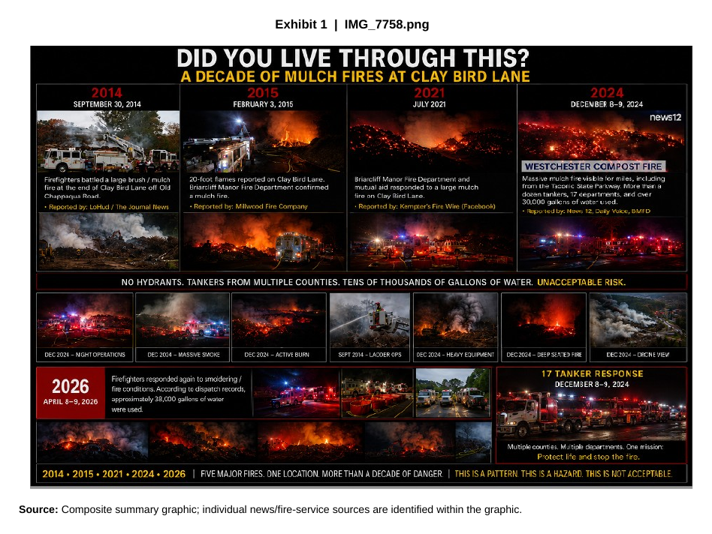
PHOTO / SOURCE RECORD — PAGE 2
121 Clay Bird Lane — Fire & Emergency Response History

Slide 29
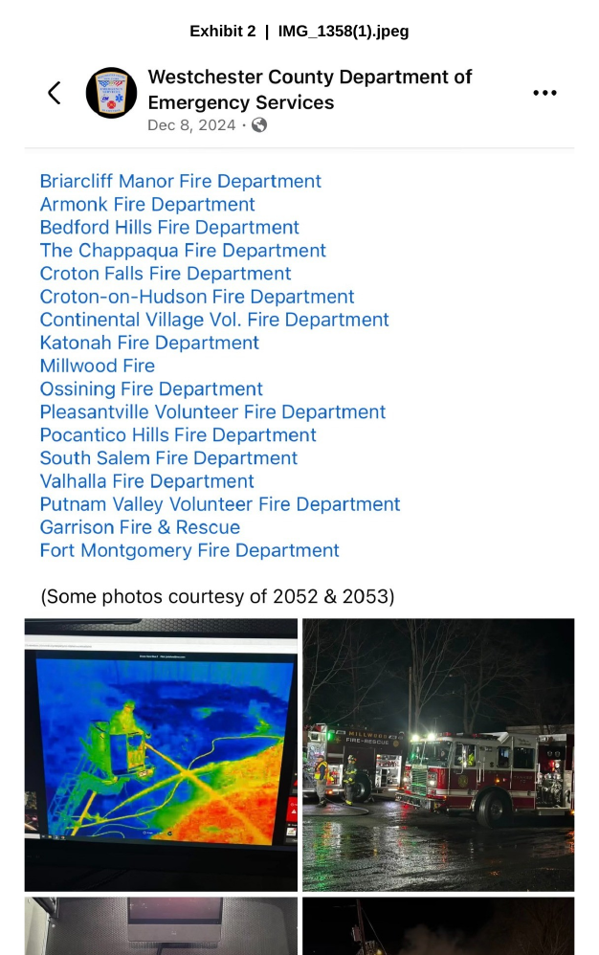
PHOTO / SOURCE RECORD — PAGE 3
121 Clay Bird Lane — Fire & Emergency Response History

Slide 30
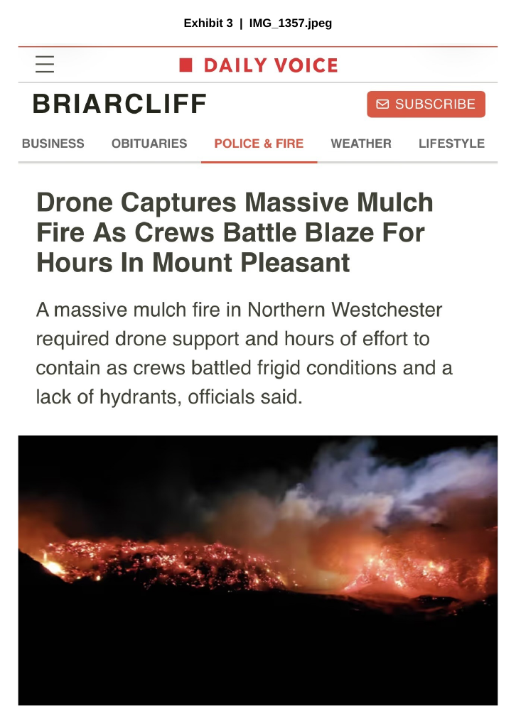
PHOTO / SOURCE RECORD — PAGE 4
121 Clay Bird Lane — Fire & Emergency Response History

Slide 31
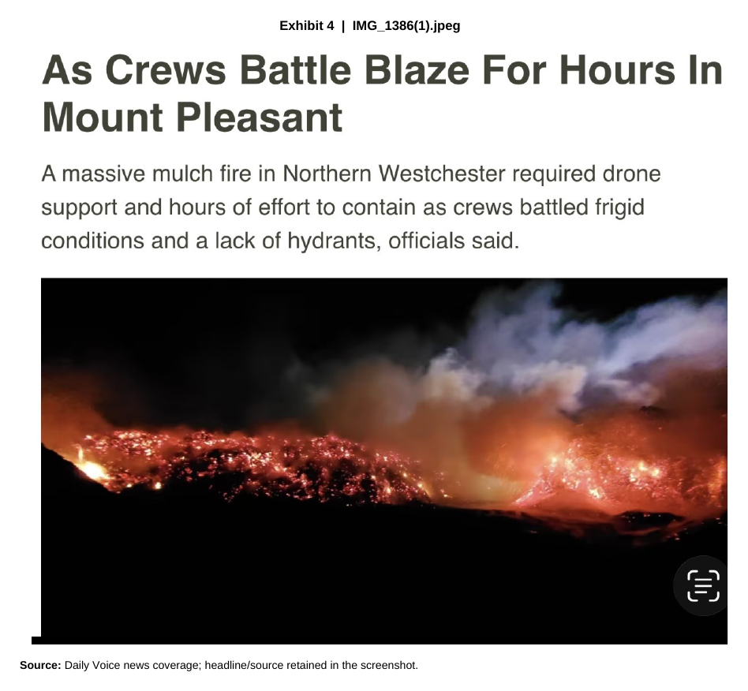
PHOTO / SOURCE RECORD — PAGE 5
121 Clay Bird Lane — Fire & Emergency Response History

Slide 32
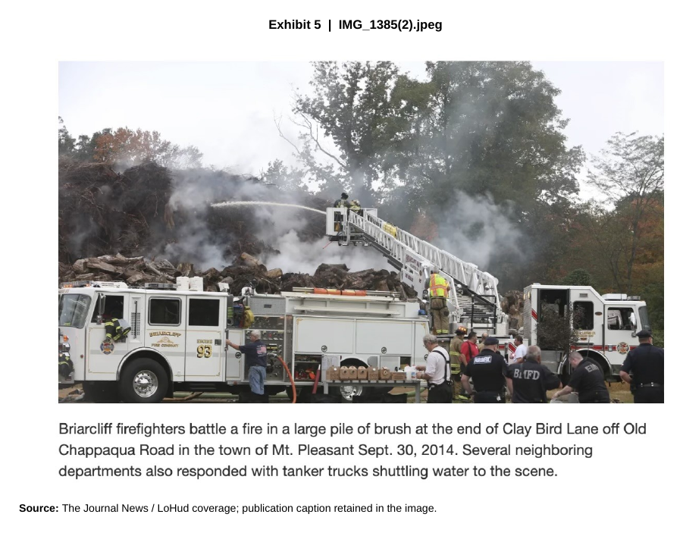
PHOTO / SOURCE RECORD — PAGE 6
121 Clay Bird Lane — Fire & Emergency Response History

Slide 33
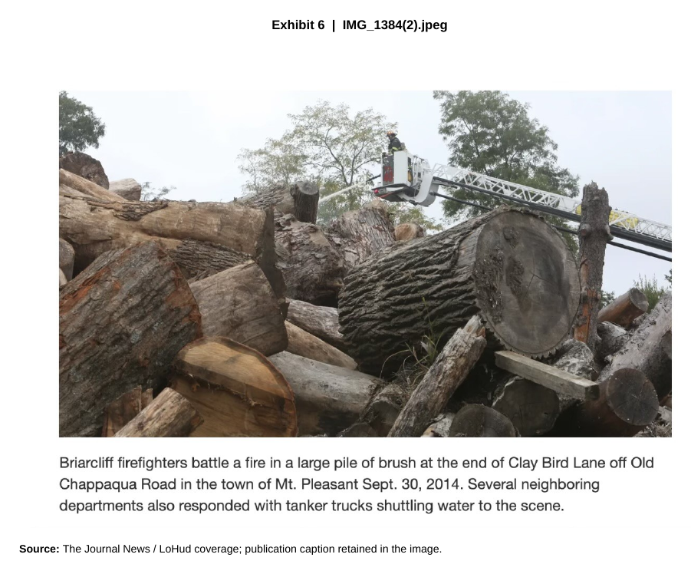
PHOTO / SOURCE RECORD — PAGE 7
121 Clay Bird Lane — Fire & Emergency Response History

Slide 34
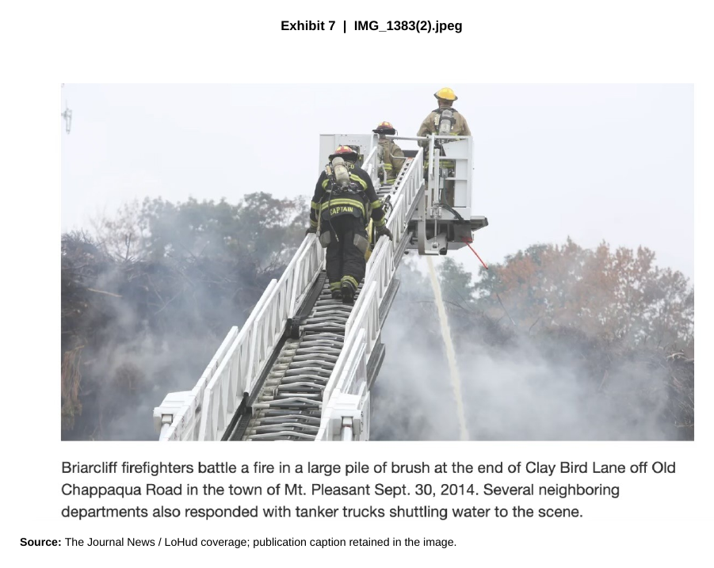
PHOTO / SOURCE RECORD — PAGE 8
121 Clay Bird Lane — Fire & Emergency Response History

Slide 35
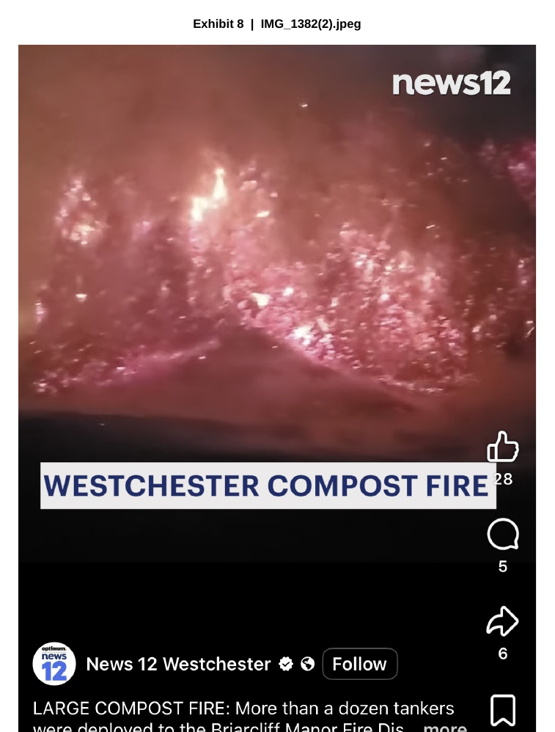
PHOTO / SOURCE RECORD — PAGE 9
121 Clay Bird Lane — Fire & Emergency Response History

Slide 36
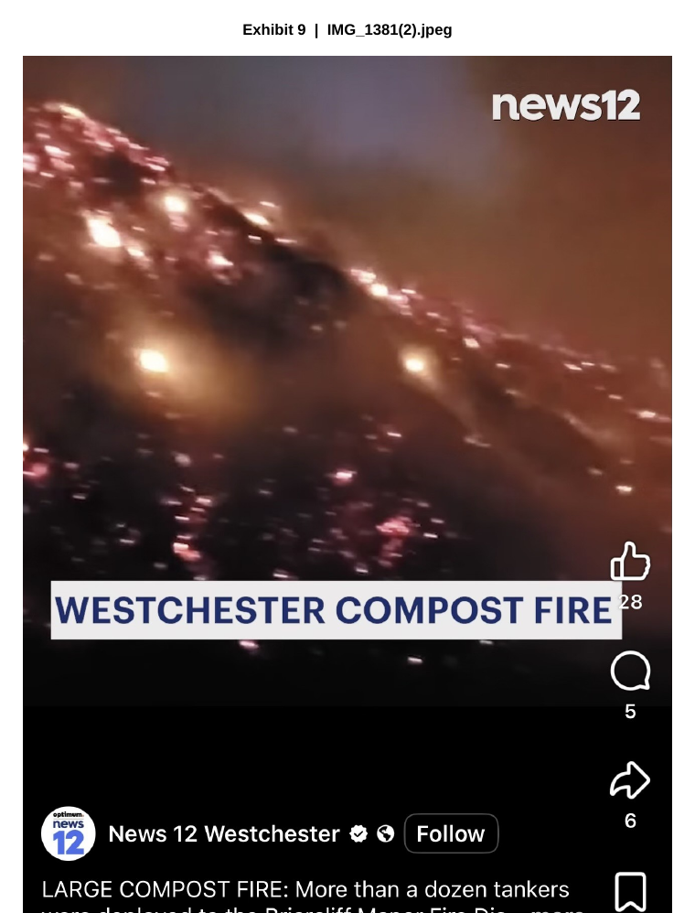
PHOTO / SOURCE RECORD — PAGE 10
121 Clay Bird Lane — Fire & Emergency Response History

Slide 37
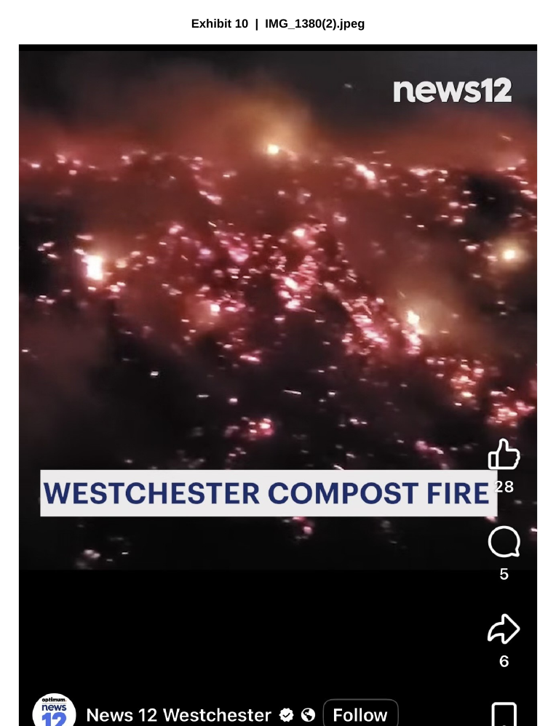
PHOTO / SOURCE RECORD — PAGE 11
121 Clay Bird Lane — Fire & Emergency Response History

Slide 38
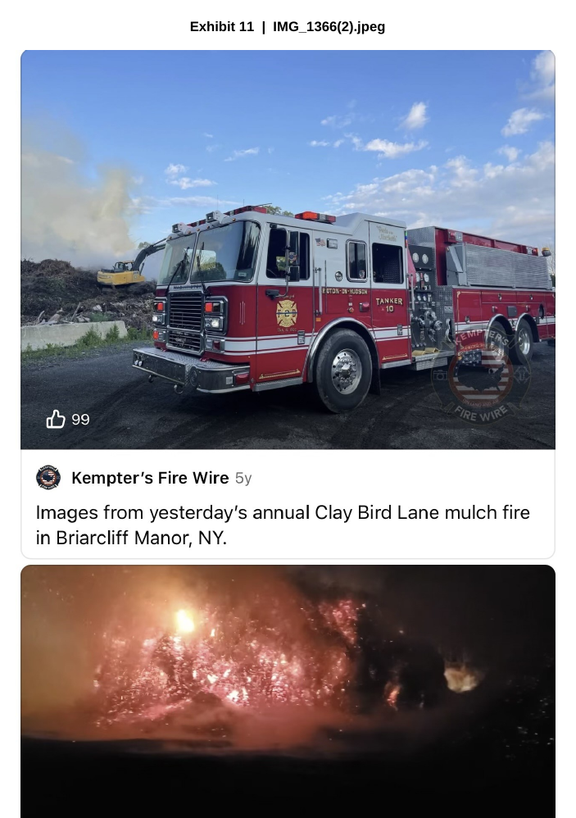
PHOTO / SOURCE RECORD — PAGE 12
121 Clay Bird Lane — Fire & Emergency Response History

Slide 39
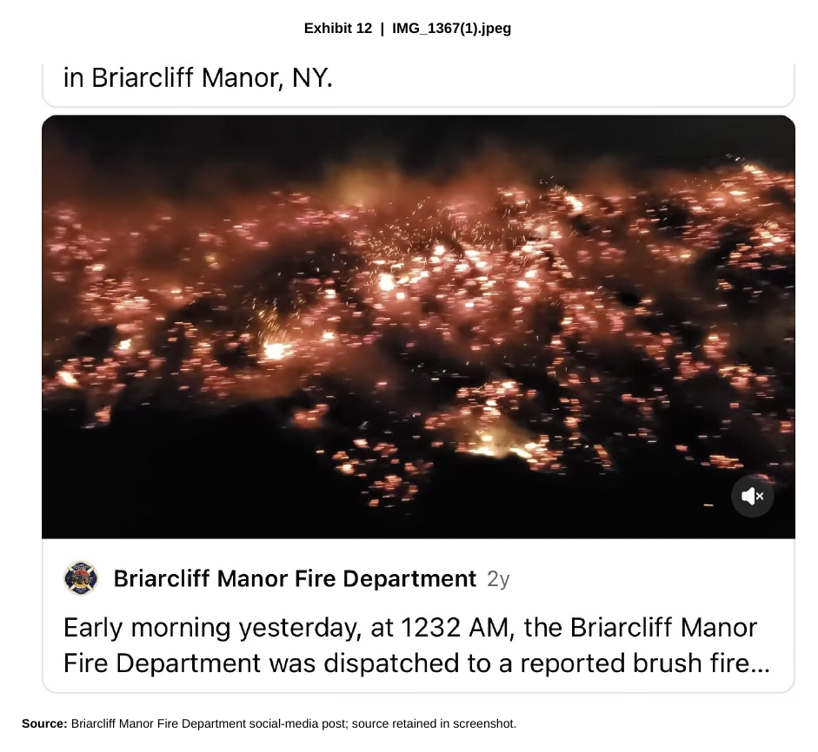
PHOTO / SOURCE RECORD — PAGE 13
121 Clay Bird Lane — Fire & Emergency Response History

Slide 40
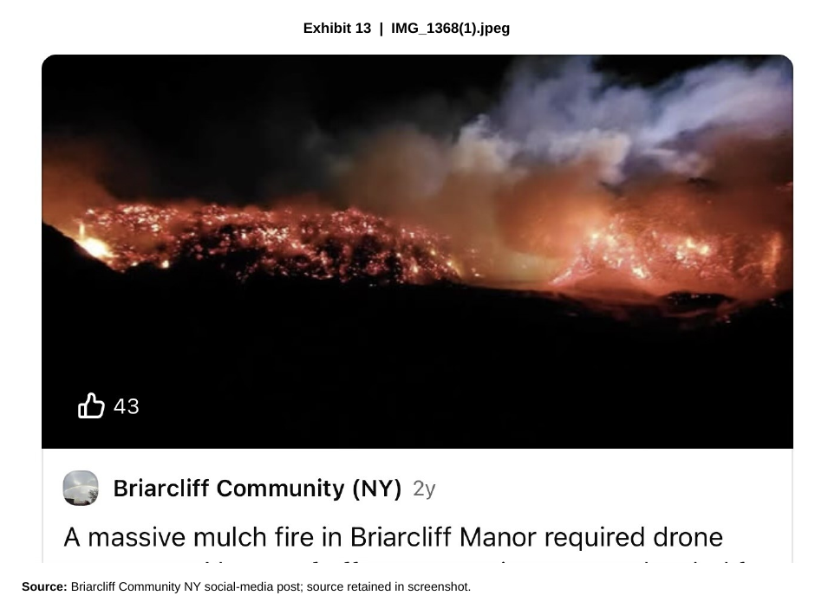
PHOTO / SOURCE RECORD — PAGE 14
121 Clay Bird Lane — Fire & Emergency Response History

Slide 41
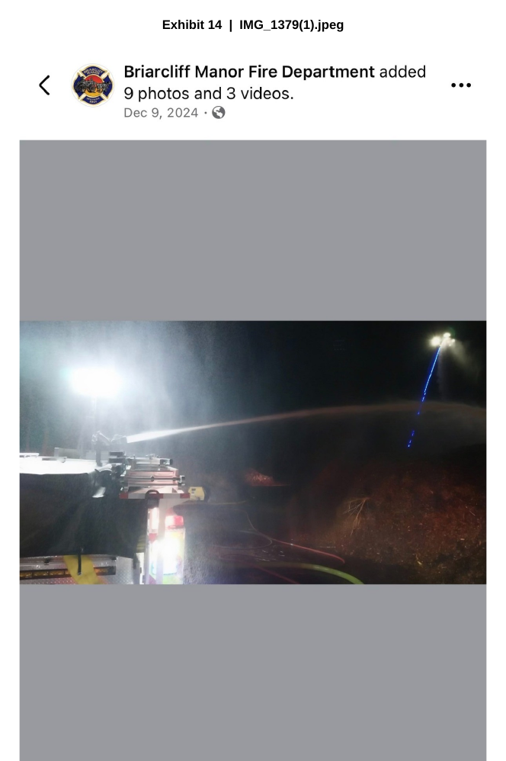
PHOTO / SOURCE RECORD — PAGE 15
121 Clay Bird Lane — Fire & Emergency Response History

Slide 42
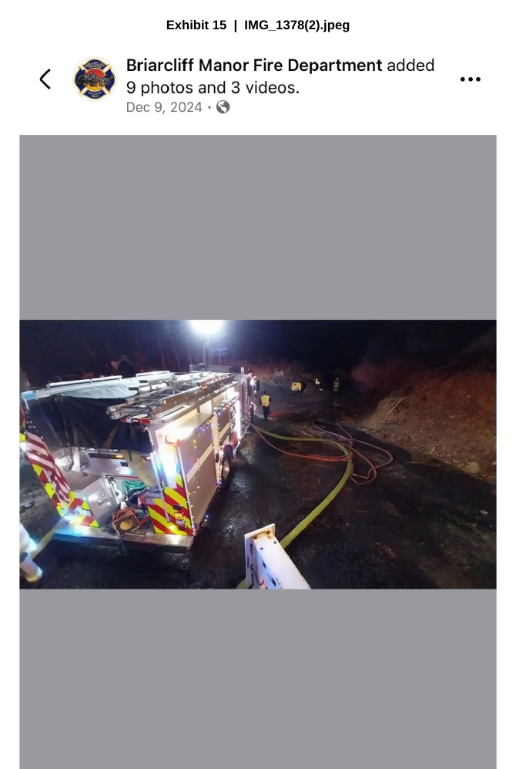
PHOTO / SOURCE RECORD — PAGE 16
121 Clay Bird Lane — Fire & Emergency Response History

Slide 43
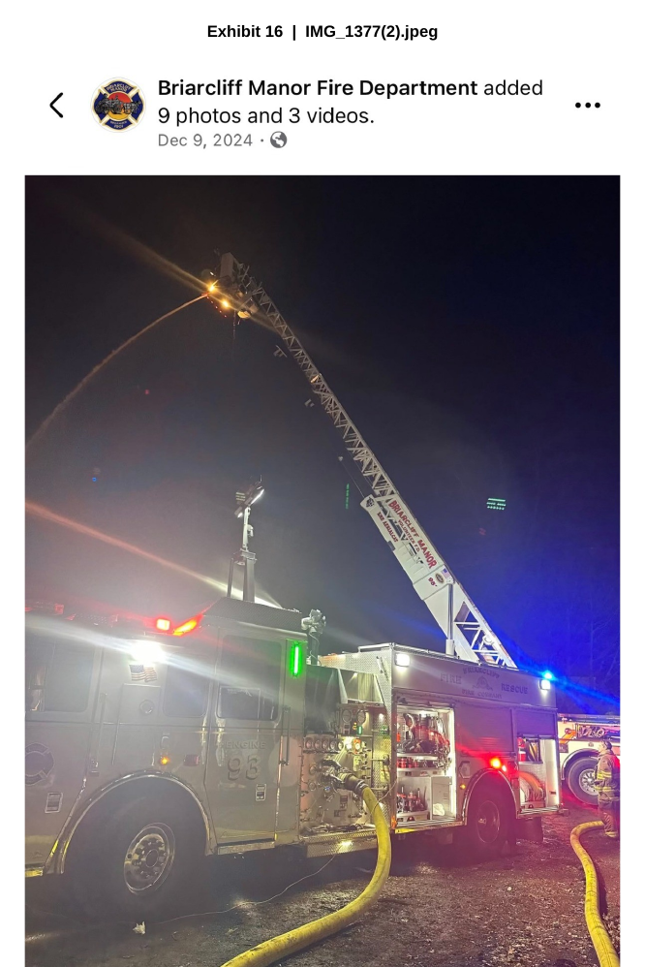
PHOTO / SOURCE RECORD — PAGE 17
121 Clay Bird Lane — Fire & Emergency Response History

Slide 44
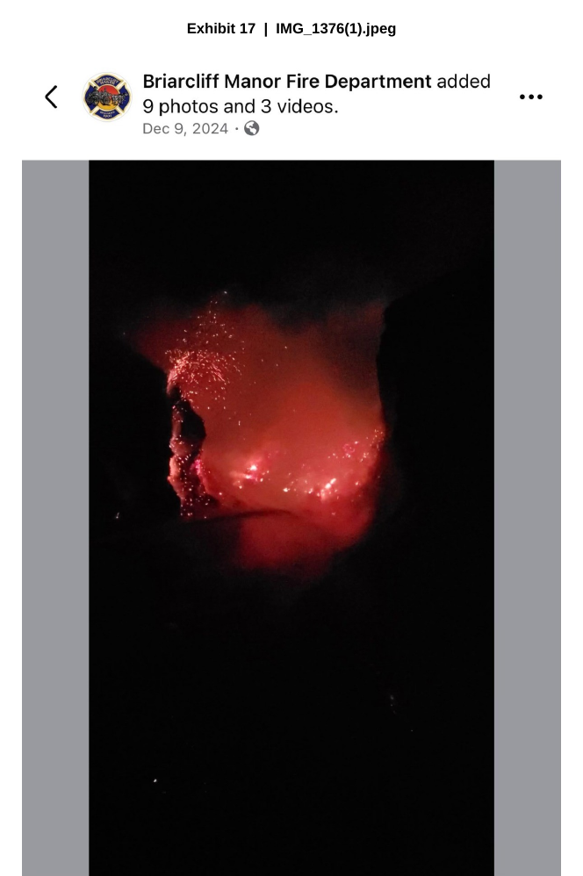
PHOTO / SOURCE RECORD — PAGE 18
121 Clay Bird Lane — Fire & Emergency Response History

Slide 45
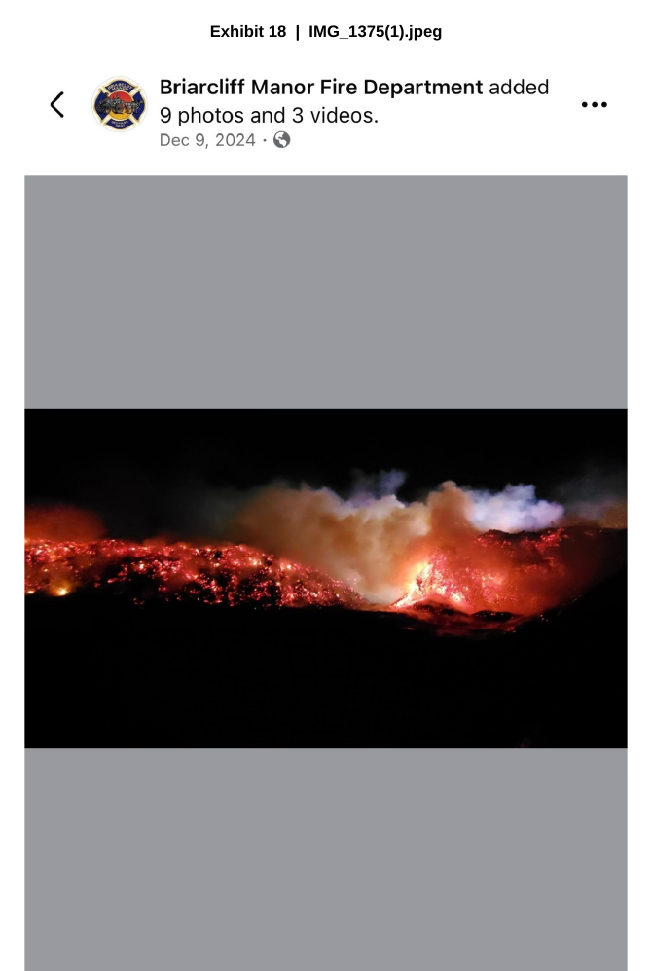
PHOTO / SOURCE RECORD — PAGE 19
121 Clay Bird Lane — Fire & Emergency Response History

Slide 46
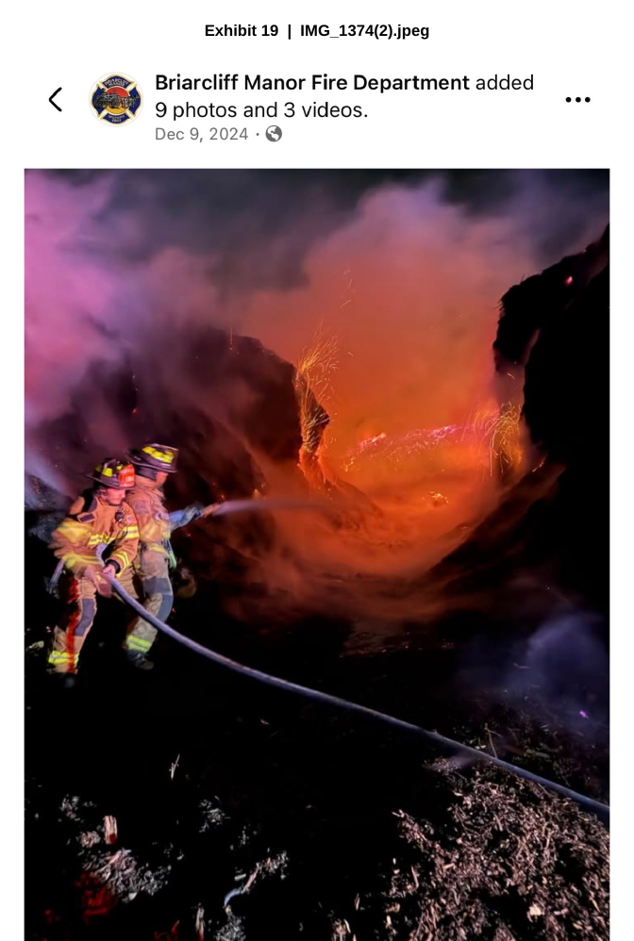
PHOTO / SOURCE RECORD — PAGE 20
121 Clay Bird Lane — Fire & Emergency Response History

Slide 47

PHOTO / SOURCE RECORD — PAGE 21
121 Clay Bird Lane — Fire & Emergency Response History

Slide 48
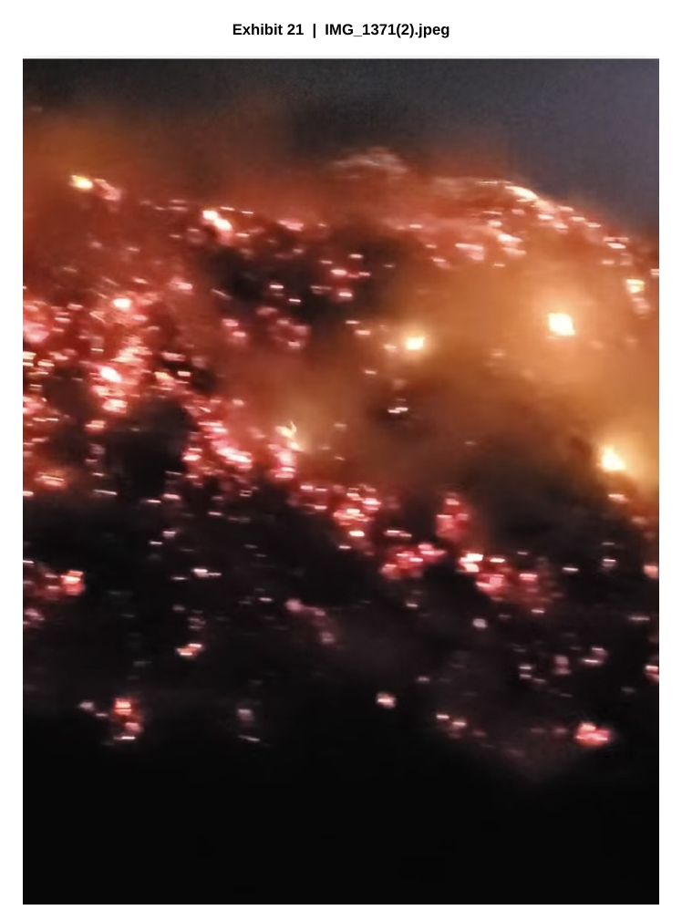
PHOTO / SOURCE RECORD — PAGE 22
121 Clay Bird Lane — Fire & Emergency Response History

Slide 49
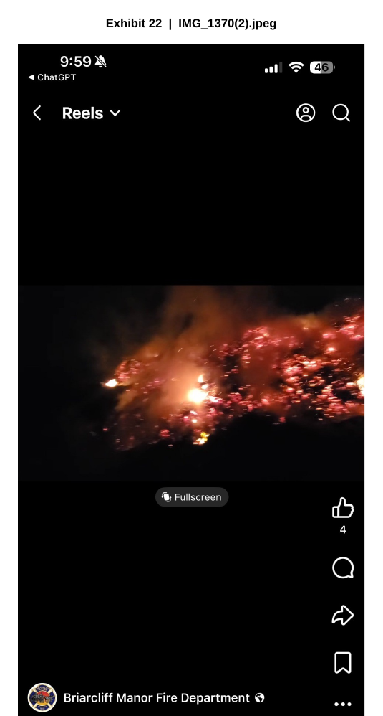
PHOTO / SOURCE RECORD — PAGE 23
121 Clay Bird Lane — Fire & Emergency Response History

Slide 50
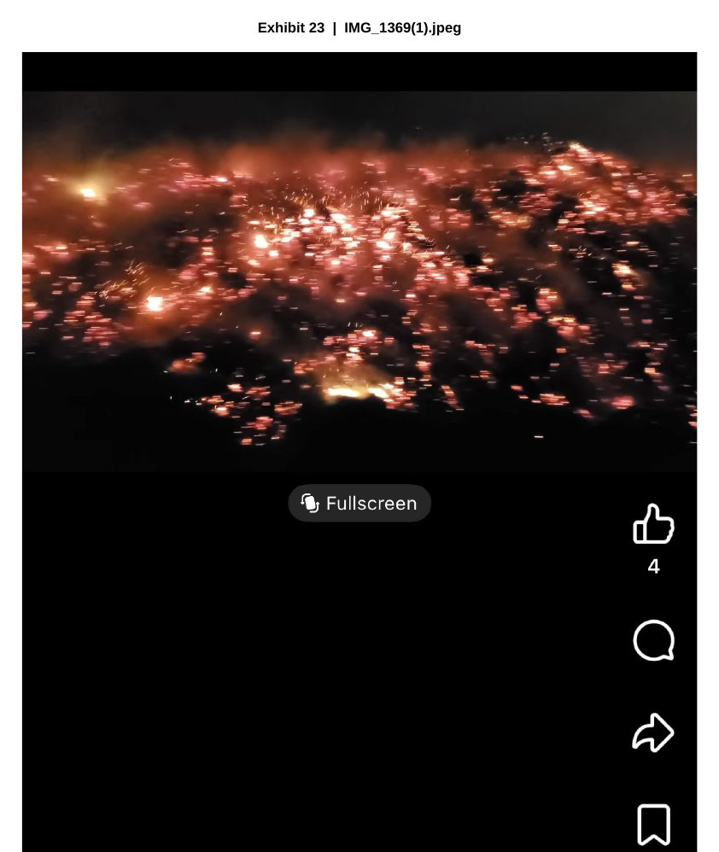
PHOTO / SOURCE RECORD — PAGE 24
121 Clay Bird Lane — Fire & Emergency Response History

Slide 51
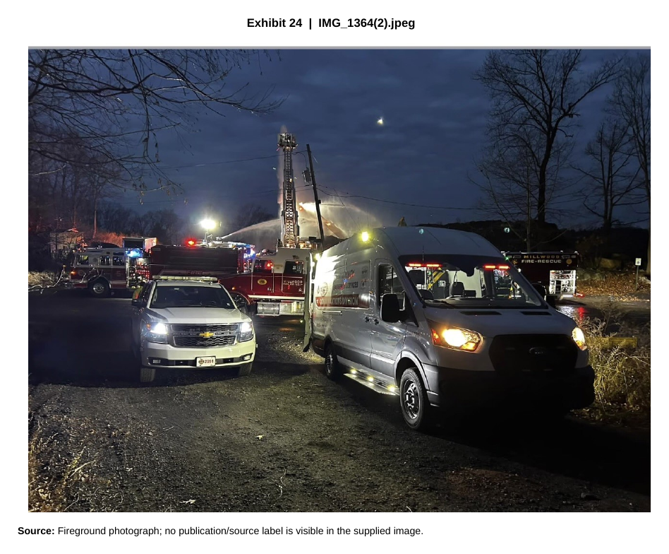
PHOTO / SOURCE RECORD — PAGE 25
121 Clay Bird Lane — Fire & Emergency Response History

Slide 52
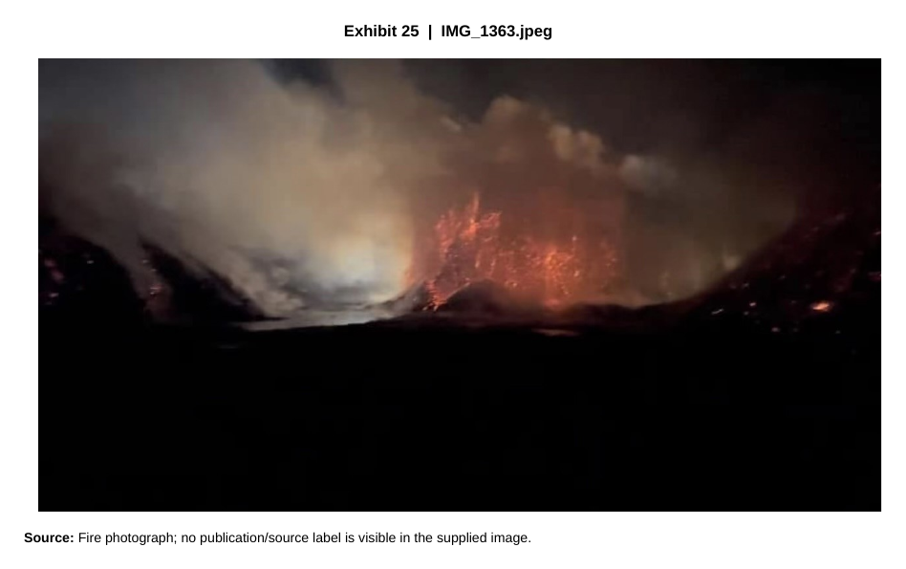
PHOTO / SOURCE RECORD — PAGE 26
121 Clay Bird Lane — Fire & Emergency Response History

Slide 53
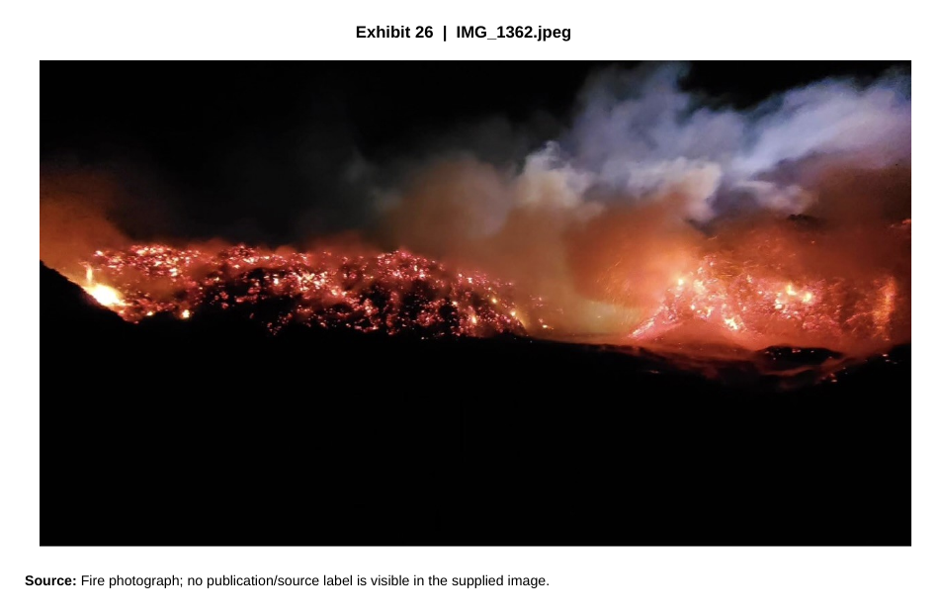
PHOTO / SOURCE RECORD — PAGE 27
121 Clay Bird Lane — Fire & Emergency Response History

Slide 54
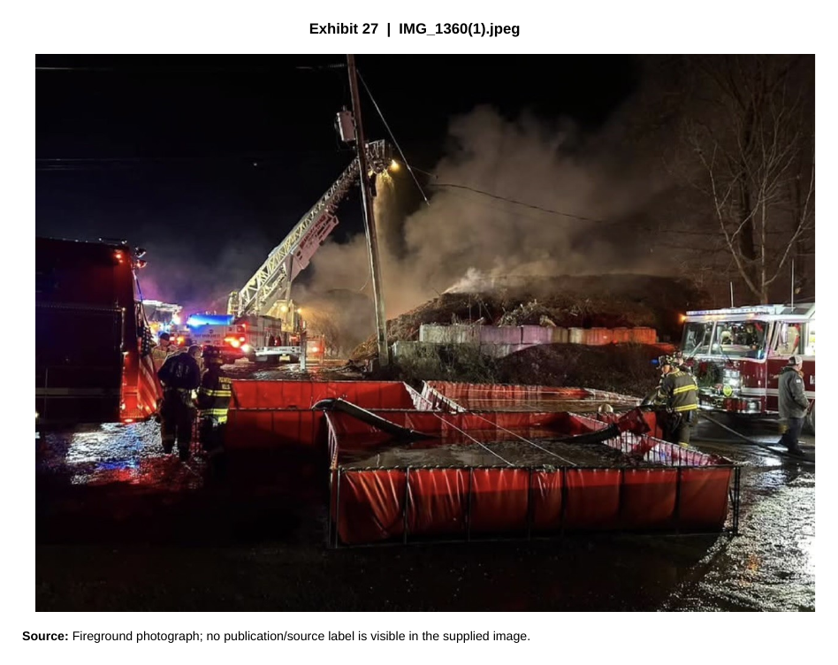
PHOTO / SOURCE RECORD — PAGE 28
121 Clay Bird Lane — Fire & Emergency Response History

Slide 55
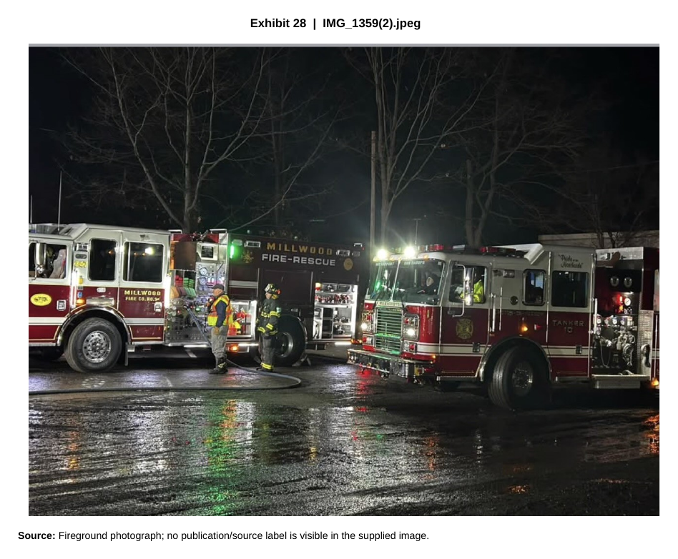
PHOTO / SOURCE RECORD — PAGE 29
121 Clay Bird Lane — Fire & Emergency Response History

Slide 56
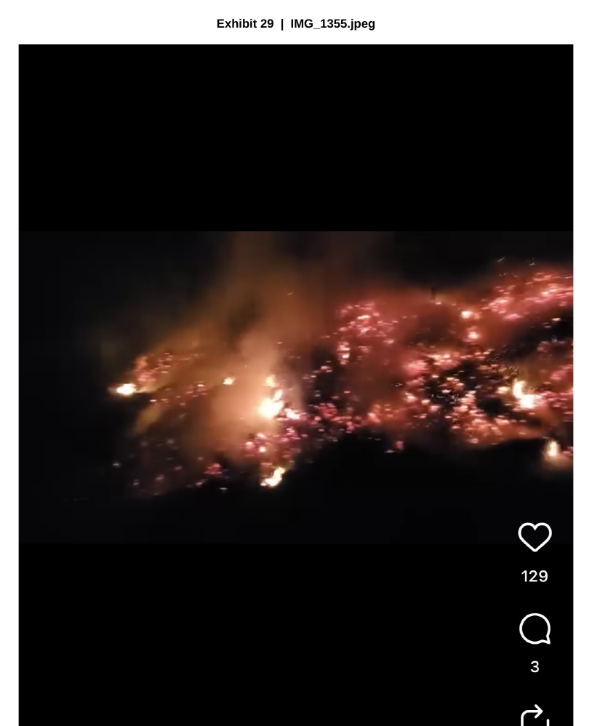
PHOTO / SOURCE RECORD — PAGE 30
121 Clay Bird Lane — Fire & Emergency Response History

Slide 57
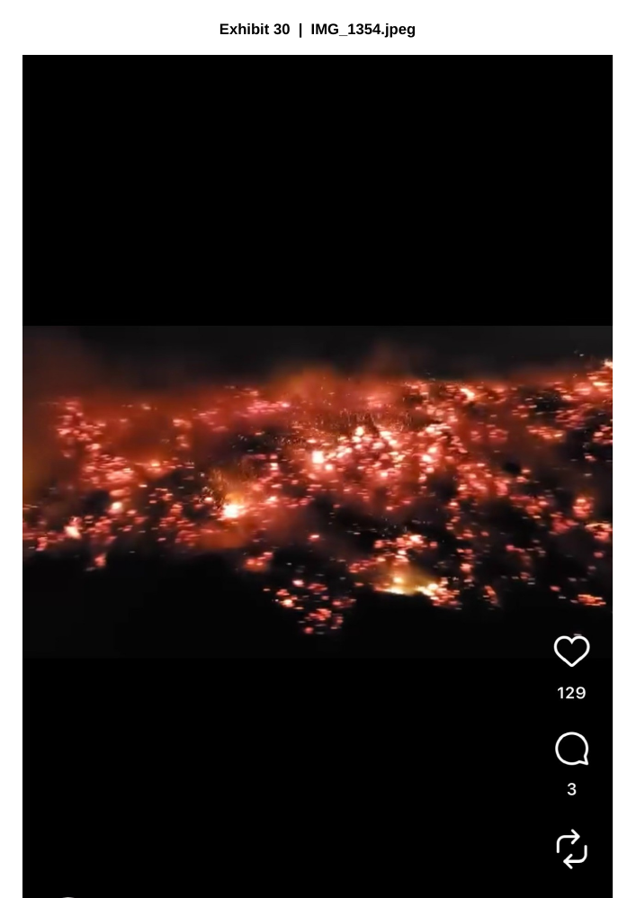
PHOTO / SOURCE RECORD — PAGE 31
121 Clay Bird Lane — Fire & Emergency Response History

Slide 58
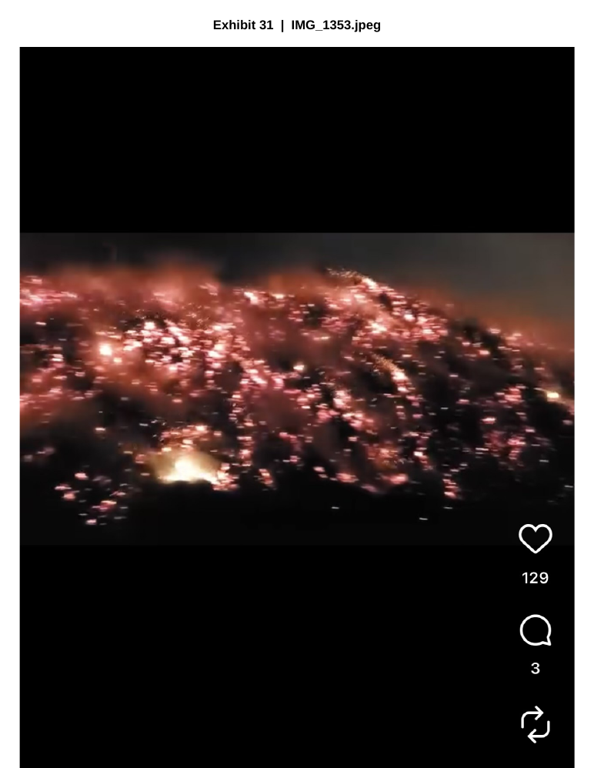
PHOTO / SOURCE RECORD — PAGE 32
121 Clay Bird Lane — Fire & Emergency Response History

Slide 59
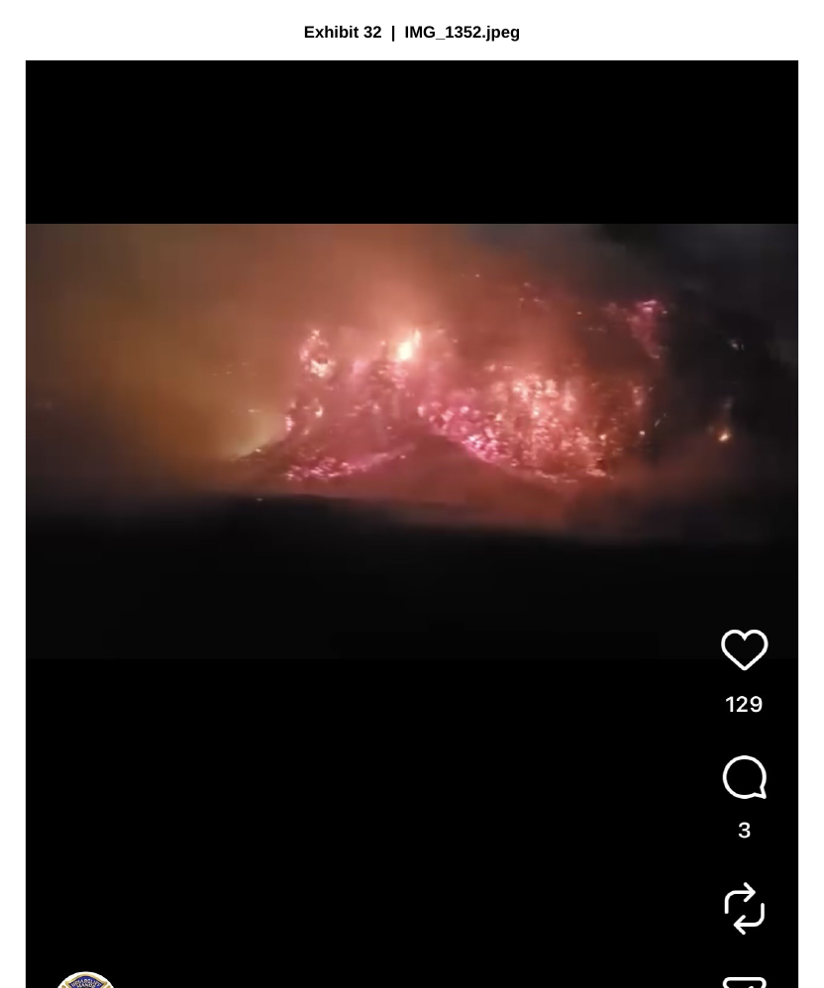
PHOTO / SOURCE RECORD — PAGE 33
121 Clay Bird Lane — Fire & Emergency Response History

Slide 60
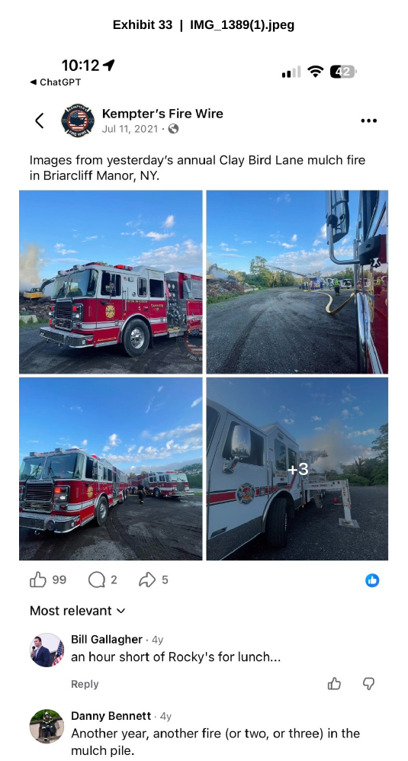
PHOTO / SOURCE RECORD — PAGE 34
121 Clay Bird Lane — Fire & Emergency Response History

Slide 61
Readable Source Index — Media / Fire Department / Town Sources (1 of 2)
1. Croton-on-Hudson FD: Tanker 10 Mutual Aid to Briarcliff Two Days in a Row — 9/29/2014. Two-day 2014 fire and mutual-aid roster.
2. Millwood Fire Company: MILLWOOD AND BRIARCLIFF BATTLE LARGE BRUSH FIRE — timing matches 9/25/2016; tanker mutual aid.
3. Millwood Fire Company: Millwood Tanker Requested to Fully Involved Mulch Fire in Briarcliff Manor — 20-foot flames; date to verify.
4. Briarcliff Manor FD: Mount Pleasant Dump Fire — 7/12/2021. Mulch piles, units, tanker mutual aid, and return call for watering.
5. Kempter's Fire Wire: Images from yesterday's annual Clay Bird Lane mulch fire — 7/11/2021. Social-media source for recurrence.
6. WPDH / Townsquare Media: Early Morning Fire Roars Near New York's Taconic State Parkway — 12/9/2024. 11 tankers, 17 departments.
7. Daily Voice: Drone Captures Massive Mulch Fire As Crews Battle Blaze For Hours — 12/10/2024. Location, no hydrants, DES/drone, 17 departments.
Based on Appendix A of the Fire Photographic and Source Record, page 35

Slide 62
Readable Source Index — Media / Fire Department / Town Sources (2 of 2)
8. Briarcliff Manor FD Instagram / Facebook: Early morning yesterday, at 1232 AM — 12/9/2024. Dispatch time, Clay Bird Lane, full-department upgrade and mutual aid.
9. News 12 Westchester / News 12 HV: Large Compost Fire — 12/2024. Video/news reference for large compost fire and more-than-a-dozen tanker response.
10. Westfair / Westchester County Business Journal: Amodio's Garden Center accused of creating nuisance — 6/24/2026. Town lawsuit and smoldering piles/DEC/environmental testing.
11. The Examiner News: Mt. Pleasant Residents Demand Answers as Mulch Facility Dispute Escalates to Police Standoff — 7/20/2026. Local coverage of dispute, fire, removal contract, RFPs, wells/groundwater.
12. Town of Mount Pleasant: Important Statement from Town Supervisor Carl Fulgenzi, Regulatory Compliance Regarding Clay Bird Ln — 8/12/2026. Town public statement; compare against documented record.
Note: Use exact source language when citing water-volume figures, department counts, or dates.
Based on Appendix A of the Fire Photographic and Source Record, pages 35–36

